Slide 1
Kupongo:
Sprint Review
The Kupongo Team

Slide 2
What I did (Kevin):
Created Meteor function to:
Collect a Coupon
Redeem a collected Coupon
See all nearby existing coupons
Get all the Coupons the user has collected
Fixed a large number of bugs in the above functions that appeared when calling them in succession or while nested.

Slide 3
Subsystems Covered:
Completed and Q/A Ready:
Coupon Collection
Coupon Redemption
Next Up:
Coupon Pinning
Fixing and testing previous stories

Slide 4
What I am going to do (Kevin):
Create backend functionality to allow Sales Execs to:
Update existing coupons
Update existing coupon templates
Stress-testing
AWS Deployment
Security

Slide 5
What I did (Nathan):
Iteration 2 subsystem(s): Coupon Creation/ Editing (front-end) & Coupon Pinning (front-end)
Wrote UAT Test Cases for Business web app
All editable fields added to Publish Pins Window (#10, 3)
Saving changes and creating a pinned coupon works for a single pin marker (including quantity)
Bug: need temporary id for pin markers to dynamically edit and save multiple pinned coupons from multiple pin markers based on a single template.
Possible solution:
var shortid = require('shortid');
tempId: shortid.generate()

Slide 6
What I am going to do (Nathan)
Iteration 3 subsystems: Coupon Pinning (front-end) and Coupon Redemption (front-end)
Fix Bug in coupon publishing (#10, 3)
Add validation control/ confirmation messages to template creation/editing (#35, 3) , and coupon editing views (#36, 3)
Develop the front end views for coupon redemption process:
summary view of redeemable coupons (#20, 5) , redacted details view (#39, 5), and redemption view (#21, 8)
Write UAT Test Cases for Customer mobile app

Slide 7
What I Did (David)
Covered Coupon Collection (front-end)
Added new assets and styling to coupon app
Custom icons for coupons (changes depending if they are close enough to redeem and such).
Custom Icon for user.
Restricted map movements
Cannot zoom out all the way.
Filtered collected coupons from map
App now keeps track of the coupons the user has collected and makes sure to not display them in the map.
Coupons collected will get removed from the map.

Slide 8
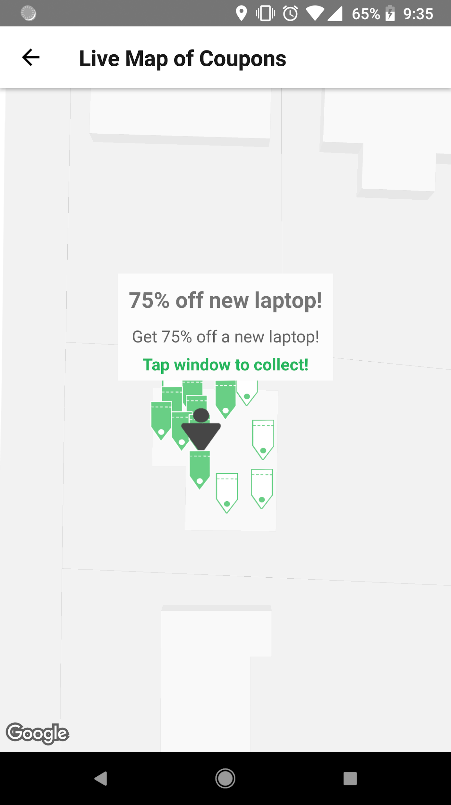
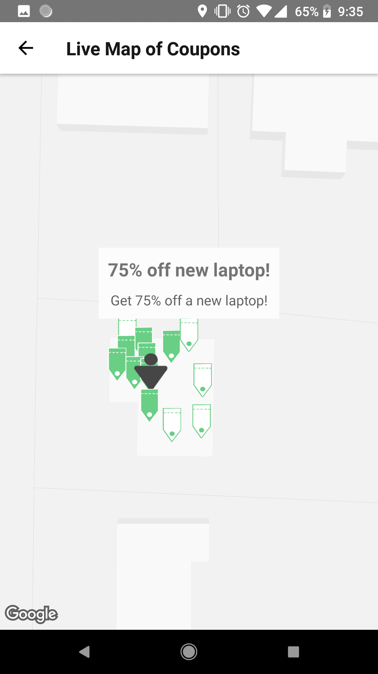

Slide 9
What I’m Going To Do (David)
Build more detailed coupon preview popup (3)
Add more styling.
Add company info, expiration dates, images, etc.
Add image preview when pinning coupons. (5)
Let company add image preview for templates.
Change style of coupons based on expiration date. (3)
Let user know which are about to be removed from map.
Add navigation between pages in app (5)
Have a tab for each page (Coupon map, Wallet, profile, settings, etc)

Slide 10
What I Did (Preston)
Created backend functionality for mobile user login.
Verify user information was entered correctly
Add new user to database
Added update password backend
New password replaces old password
Implemented email sending
Send email to user upon registering
Send email to user if password is changed

Slide 11
What I’m Going To Do (Preston)
Create proper logout functionality for users
Users can click on logout button and be safely logged out and redirected to login page
Start on restricting users from accessing certain pages
Prevent users from entering sensitive pages without being logged in
Let user recover password if forgotten
Send user an email with link to take them to an update password page

Slide 12
What I Did (Melvin)
Customer account(Front-end)
Created
Login page for returning users
Created register page for new users
Created Update password page
Issue
Connecting to meteor server from react-native app

Slide 13
What I’m Going To Do (Melvin)
Subsystem
Customer Account (mobile) Front end
Fix connection problem to meteor server
Styling (login/register/update)
Add forget password functionally

